Slide 1

Does Weather Affect the number of Burritos Consumed?

Slide 2



Point A To B
Bike Share VS. The Weather

Slide 3
….
Lets take you to cold winter day . The snow is falling and Christmas music is playing on the radio . This situation in itself seems ideal ... but then you realize your sitting in traffic on Bay St , your destination is 5 mins away and if you squint really hard you can see it. Life, time, and everyone on their bike share is just passing you by. Bike Share is such a growing trend in the city . There are over 5000 bikes, 465 stations that span across 100k in the city of Toronto. The ride share program offer many benefits as both a member and casual user. We as team decide to in-depth explore the fascinating world of bike share. The situation that we decided to research was " does weather effect the number of user " Well we have the answer for you but your going to have to listen to all our boring facts, view our graphs , and watch our code run in order to get that answer.

Slide 4

Questions That Peaked our Interest
How does the temperature and precipitation levels impact bike share usage for members and casual users?
How does the temperature and precipitation levels impact bike share distance for members and casual users ?
What is the overall impact on the location of the bike share?

Slide 5
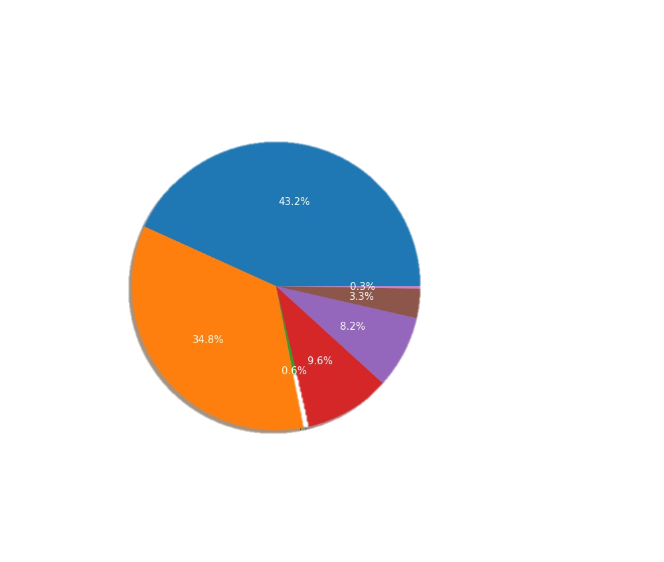
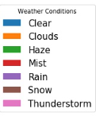
How does the weather conditions impact bike share usage for members and casual users?

Slide 6
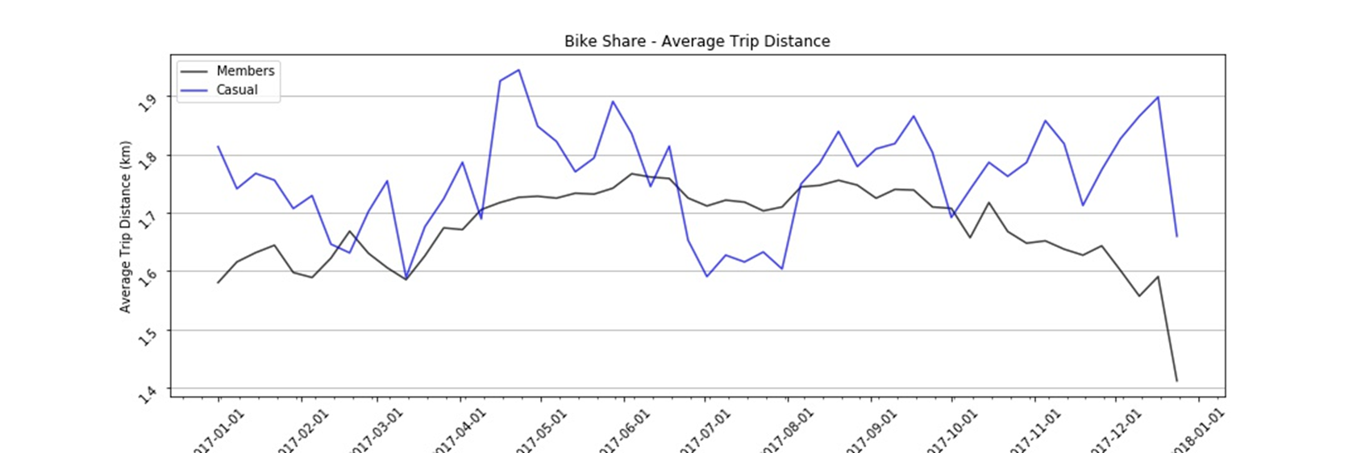
How does bike share distance change throughout the year ?(Avg Trip Distance)

Slide 7
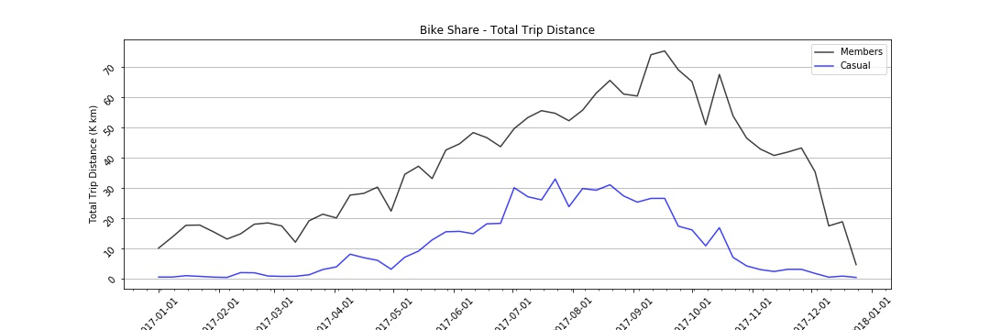
How does bike share distance change throughout the year ?(Total Trip Distance)

Slide 8
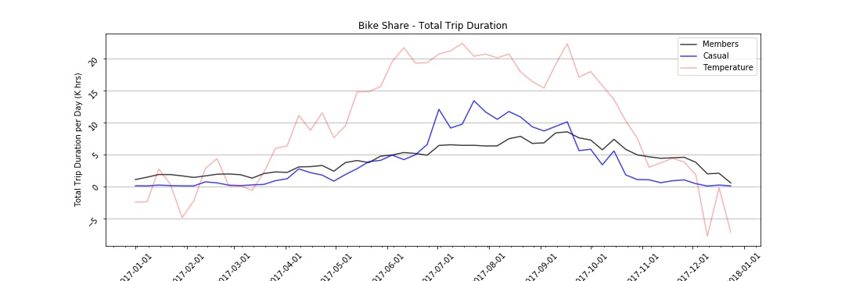
Total Trip Duration

Slide 9
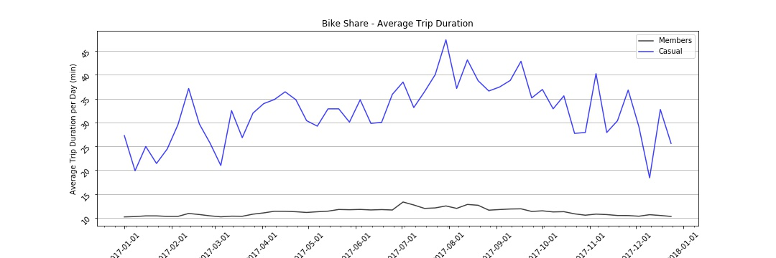
Avg Trip Duration

Slide 10

Data Sources
Bike Share Data: https://open.toronto.ca/dataset/bike-share-toronto-ridership-data/
Open Weather Map: https://openweathermap.org/api
Google Geolocation API: https://developers.google.com/maps/documentation/geolocation/intro

Slide 11
Data Exploration / Clean Up Process
Bike Share Data:
Bike Share data provided the following information per each trip:
Trip ID
Trip duration in seconds
Start location as street intersection
End location as street intersection
User Type (member/casual)
Bike Share data contained information on about 1.5 million trips
We used Google API to lookup latitude and longitude for distinct list of drop off / pick up bike stations (about 300-400 API calls)
We used the above coordinates to calculate the distance (linear straight line) between the unique combinations of drop off / pick up locations (about 60,000 calculations)

Slide 12
Data Exploration / Clean Up Process
Weather:
We grabbed the historical weather data for 2017 from Open Weather Map
Data was provided on an hourly basis
We aggregated the data per day to get the following information:
  Average temperature
  Average precipitation
  Most common weather description for each day (cloudy, mist, rain, etc.)

Slide 13
Jupyter Code
https://github.com/wind8898/Super-Awesome-Team/tree/master/clean%20data%20sets

Slide 14
Analysis Process
Once we had all 3 data sets, we merged the data and calculated the following:
Total number of trips per day
Total trip duration per day
Average trip duration per day
Total distance traveled per day
Average distance travelled per day
Average temperature per day
Average precipitation per day
Weather description per day

Slide 15

What Do Our Findings Mean
There is more of an impact of casual users than members when the weather is different .
The precipitation has more impact that the actual weather.

Slide 16
What Did We Learn
We learned that the location of where the Bike Shares are more common in the Central GTA (refer to our heat map )
The most consuming part of the project is cleaning the data to come to our final conclusion .

Slide 17
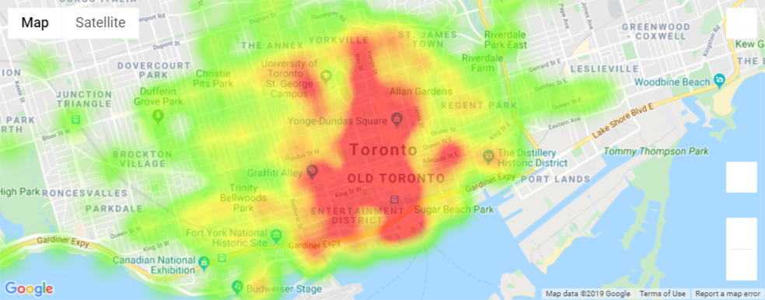
Bike Share Locations Heat Map

Slide 18


THE END
( please don’t clap all at once)

